Slide 1
IBM DB2 Pre-SSMA Query Guidance
March 2017
Data Migration Jumpstart Engineering Team

Slide 2
What is it?
SQL query that hits IBM DB2 system tables
So far, only tested so far on IBM DB2 LUW version 11.1
Non-evasive query
Count of objects by schema and object type
Gives a rough estimate of ‘Raw Data’ in each schema
Provides a sizing of tables in each schema
Results are stored in a CSV
Data Migration Jumpstart Engineering Team

Slide 3
Looking for testers and code reviewers!
Would like to test on other DB2 platforms and editions:
DB2 zOS
Versions prior to 11.1
Data Migration Jumpstart Engineering Team

Slide 4
Benefits
Helps classify schemas
(simple, moderate, complex, custom)
Helps target high-profile schemas for analysis
Helps identify user accounts too
Sizing information
Goes beyond identifying SSMA objects (only a couple, working on adding more)
Data Migration Jumpstart Engineering Team

Slide 5
Object Types
BLOB
CLOB
Table Partition
Raw Data (MB)
Table Sizing
Function
Procedure
Method
Index
Materialized Query Table
Sequence
Alias
Table
Trigger
View
Data Migration Jumpstart Engineering Team

Slide 6
The query
--
-- BLOB and CLOB
--
select
trim(e.OS_NAME) CONCAT ',' CONCAT
trim(e.HOST_NAME) CONCAT ',' CONCAT
trim(i.INST_NAME) CONCAT ',' CONCAT
trim(i.SERVICE_LEVEL) CONCAT ',' CONCAT
trim((SELECT CURRENT SERVER FROM SYSIBM.SYSDUMMY1)) CONCAT ',' CONCAT
trim(v.TABSCHEMA) CONCAT ',' CONCAT
v.typename CONCAT ',' CONCAT
COALESCE(count(v.typename), 1) CONCAT ',1,1'
from syscat.columns as v, TABLE(SYSPROC.ENV_GET_SYS_INFO()) as e, TABLE(SYSPROC.ENV_GET_INST_INFO()) as i
where v.typename in ('BLOB', 'CLOB')
group by e.OS_NAME, i.SERVICE_LEVEL, i.INST_NAME, e.HOST_NAME, v.TABSCHEMA, v.typename;
--
-- TABLE PARTITIONS
--
select
trim(e.OS_NAME) CONCAT ',' CONCAT
trim(e.HOST_NAME) CONCAT ',' CONCAT
trim(i.INST_NAME) CONCAT ',' CONCAT
trim(i.SERVICE_LEVEL) CONCAT ',' CONCAT
trim((SELECT CURRENT SERVER FROM SYSIBM.SYSDUMMY1)) CONCAT ',' CONCAT
trim(v.TABSCHEMA) CONCAT ',' CONCAT
'TABLE PARTITION' CONCAT ',' CONCAT
COALESCE(count(v.TABNAME), 1) CONCAT ',1,1'
from syscat.TABDETACHEDDEP as v, TABLE(SYSPROC.ENV_GET_SYS_INFO()) as e, TABLE(SYSPROC.ENV_GET_INST_INFO()) as i
group by e.OS_NAME, i.SERVICE_LEVEL, i.INST_NAME, e.HOST_NAME, v.TABSCHEMA;
Data Migration Jumpstart Engineering Team

Slide 7
More query (Partial code)
--
-- ALIASES
--
select
trim(e.OS_NAME) CONCAT ',' CONCAT
trim(e.HOST_NAME) CONCAT ',' CONCAT
trim(i.INST_NAME) CONCAT ',' CONCAT
trim(i.SERVICE_LEVEL) CONCAT ',' CONCAT
trim((SELECT CURRENT SERVER FROM SYSIBM.SYSDUMMY1)) CONCAT ',' CONCAT
trim(v.TABSCHEMA) CONCAT ',' CONCAT
'ALIAS' CONCAT ',' CONCAT
COALESCE(count(v.TABNAME), 1) CONCAT ',1,1'
from syscat.tables as v, TABLE(SYSPROC.ENV_GET_SYS_INFO()) as e, TABLE(SYSPROC.ENV_GET_INST_INFO()) as i
where v.type = 'A'
group by e.OS_NAME, i.SERVICE_LEVEL, i.INST_NAME, e.HOST_NAME, v.TABSCHEMA;
--
-- MATERIALIZED QUERY TABLES
--
select
trim(e.OS_NAME) CONCAT ',' CONCAT
trim(e.HOST_NAME) CONCAT ',' CONCAT
trim(i.INST_NAME) CONCAT ',' CONCAT
trim(i.SERVICE_LEVEL) CONCAT ',' CONCAT
trim((SELECT CURRENT SERVER FROM SYSIBM.SYSDUMMY1)) CONCAT ',' CONCAT
trim(v.TABSCHEMA) CONCAT ',' CONCAT
'MATERIALIZED QUERY TABLE' CONCAT ',' CONCAT
COALESCE(count(v.TABNAME), 1) CONCAT ',1,1'
from syscat.tables as v, TABLE(SYSPROC.ENV_GET_SYS_INFO()) as e, TABLE(SYSPROC.ENV_GET_INST_INFO()) as i
where v.type = 'S'
group by e.OS_NAME, i.SERVICE_LEVEL, i.INST_NAME, e.HOST_NAME, v.TABSCHEMA;
--
-- INDEXES
--
select
trim(e.OS_NAME) CONCAT ',' CONCAT
trim(e.HOST_NAME) CONCAT ',' CONCAT
trim(i.INST_NAME) CONCAT ',' CONCAT
trim(i.SERVICE_LEVEL) CONCAT ',' CONCAT
trim((SELECT CURRENT SERVER FROM SYSIBM.SYSDUMMY1)) CONCAT ',' CONCAT
trim(v.INDSCHEMA) CONCAT ',' CONCAT
'INDEX' CONCAT ',' CONCAT
COALESCE(count(v.INDNAME), 1) CONCAT ',1,1'
from syscat.indexes as v, TABLE(SYSPROC.ENV_GET_SYS_INFO()) as e, TABLE(SYSPROC.ENV_GET_INST_INFO()) as i
group by e.OS_NAME, i.SERVICE_LEVEL, i.INST_NAME, e.HOST_NAME, v.INDSCHEMA;
Data Migration Jumpstart Engineering Team

Slide 8
Last part of query
--
-- RAW DATA
--
select
trim(e.OS_NAME) CONCAT ',' CONCAT
trim(e.HOST_NAME) CONCAT ',' CONCAT
trim(i.INST_NAME) CONCAT ',' CONCAT
trim(i.SERVICE_LEVEL) CONCAT ',' CONCAT
trim((SELECT CURRENT SERVER FROM SYSIBM.SYSDUMMY1)) CONCAT ',' CONCAT
trim(v.TABSCHEMA) CONCAT ',,' CONCAT
'RAW DATA (MB)' CONCAT ',' CONCAT
round((sum(v.CARD * v.AVGROWSIZE) * 0.000001), 2)
from syscat.tables as v, TABLE(SYSPROC.ENV_GET_SYS_INFO()) as e, TABLE(SYSPROC.ENV_GET_INST_INFO()) as i
group by e.OS_NAME, i.SERVICE_LEVEL, i.INST_NAME, e.HOST_NAME, v.TABSCHEMA;
--
-- TABLE SIZING
--
select
trim(e.OS_NAME) CONCAT ',' CONCAT
trim(e.HOST_NAME) CONCAT ',' CONCAT
trim(i.INST_NAME) CONCAT ',' CONCAT
trim(i.SERVICE_LEVEL) CONCAT ',' CONCAT
trim((SELECT CURRENT SERVER FROM SYSIBM.SYSDUMMY1)) CONCAT ',' CONCAT
trim(v.TABSCHEMA) CONCAT ',' CONCAT
v.TABNAME CONCAT ',' CONCAT
'TABLE SIZING' CONCAT ',' CONCAT
v.CARD CONCAT ',' CONCAT
v.AVGROWSIZE CONCAT ',' CONCAT
(v.CARD * v.AVGROWSIZE)
from syscat.tables as v, TABLE(SYSPROC.ENV_GET_SYS_INFO()) as e, TABLE(SYSPROC.ENV_GET_INST_INFO()) as i
where v.type = 'T';
Data Migration Jumpstart Engineering Team

Slide 9
Running the query
Run 1x in each instance
Helps to eliminate schemas you are not interested in
Run from DB2 command line (Linux example):
Use the command line to take input query as .sql and specify the output file
[db2admin@host ~]$ db2 –txf DB2_Pre_SSMA_v0.1.sql –z DB2_PreSSMAOutput.csv
Data Migration Jumpstart Engineering Team

Slide 10
The output
Linux,db2host,db2admin,DB2 v11.1.1.1,SAMPLE,DB2ADMIN,BLOB,1,1,1 Linux,db2host,db2admin,DB2 v11.1.1.1,SAMPLE,DB2ADMIN,CLOB,1,1,1 Linux,db2host,db2admin,DB2 v11.1.1.1,SAMPLE,SYSCAT,BLOB,4,1,1 Linux,db2host,db2admin,DB2 v11.1.1.1,SAMPLE,SYSCAT,CLOB,40,1,1 Linux,db2host,db2admin,DB2 v11.1.1.1,SAMPLE,SYSIBM,BLOB,57,1,1 Linux,db2host,db2admin,DB2 v11.1.1.1,SAMPLE,SYSIBM,CLOB,57,1,1 Linux,db2host,db2admin,DB2 v11.1.1.1,SAMPLE,SYSIBMADM,CLOB,13,1,1 Linux,db2host,db2admin,DB2 v11.1.1.1,SAMPLE,SYSTOOLS,BLOB,1,1,1 Linux,db2host,db2admin,DB2 v11.1.1.1,SAMPLE,DB2ADMIN,ALIAS,5,1,1 Linux,db2host,db2admin,DB2 v11.1.1.1,SAMPLE,SYSPUBLIC,ALIAS,1,1,1 Linux,db2host,db2admin,DB2 v11.1.1.1,SAMPLE,DB2ADMIN,MATERIALIZED QUERY TABLE,1,1,1 Linux,db2host,db2admin,DB2 v11.1.1.1,SAMPLE,DB2ADMIN,INDEX,27,1,1 Linux,db2host,db2admin,DB2 v11.1.1.1,SAMPLE,SYSIBM,INDEX,404,1,1 Linux,db2host,db2admin,DB2 v11.1.1.1,SAMPLE,SYSTOOLS,INDEX,3,1,1
Data Migration Jumpstart Engineering Team

Slide 11
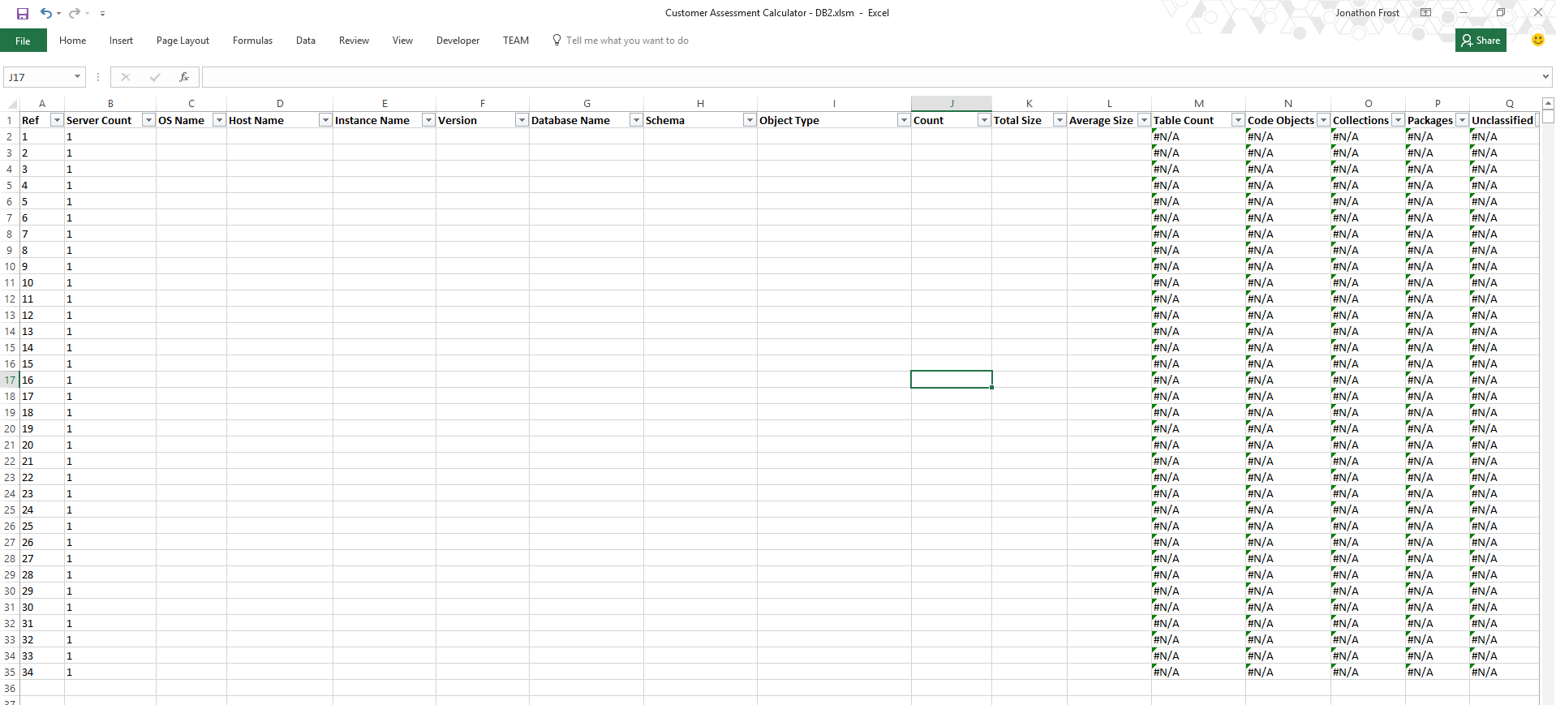
Using the output
The Customer Assessment Calculator
Data Migration Jumpstart Engineering Team

Slide 12
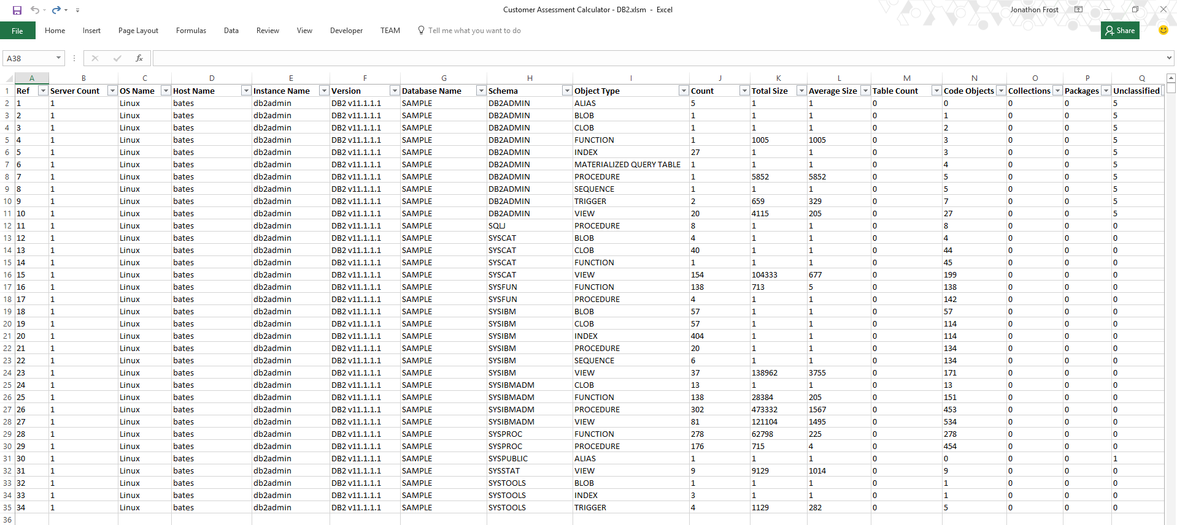
Populate the Calculator with the csv
Quick Estimate for Database Work
Data Migration Jumpstart Engineering Team

Slide 13

©2016 Microsoft Corporation. All rights reserved.
Data Migration Jumpstart Engineering Team

